Slide 1
The Effects of Temperature and Music on Working Memory
Group Members:
Natasha Kramer, Nicholas Davis, Ramon Soto Alvarez, Saffra Parks, Valissa Davis

Slide 2
Introduction
Do the interaction of high temperature and music have a significant impact on short-term working memory for college-aged students?
What are the null and alternative hypotheses?
Heat Factor:
H_{o}: µ_{heat} = µ_{no heat}
H_{a}: at least one of the population means is different (µ_{heat} ≠ µ_{no heat} )
Music Factor:
H_{o}: µ_{music} = µ_{no music}
H_{a}: at least one of the population means is different (µ_{music} ≠ µ_{no heat} )
Interaction:
H_{o}: There is no interaction between heat and music.
H_{a}: There is an interaction between heat and music.

Slide 3
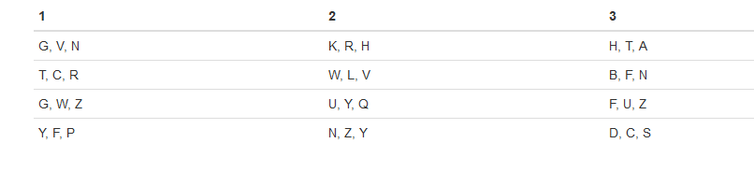
Methods
Participants
60 participants, 43% Female
65% Caucasian
Materials
12 random, nonsense letters (generated randomly through using R) for the working memory task (below is an example of what participants saw)

Slide 4


Methods
Procedures
Randomization: Each student that was willing to participate was included in the study. The students were put into one of the four controlled rooms based on which room was available at the time the participant was available.
Controlling: The four different room types with the conditions each of them have (music with heat, music with no heat, no music and no heat, and no music with heat).

Slide 5
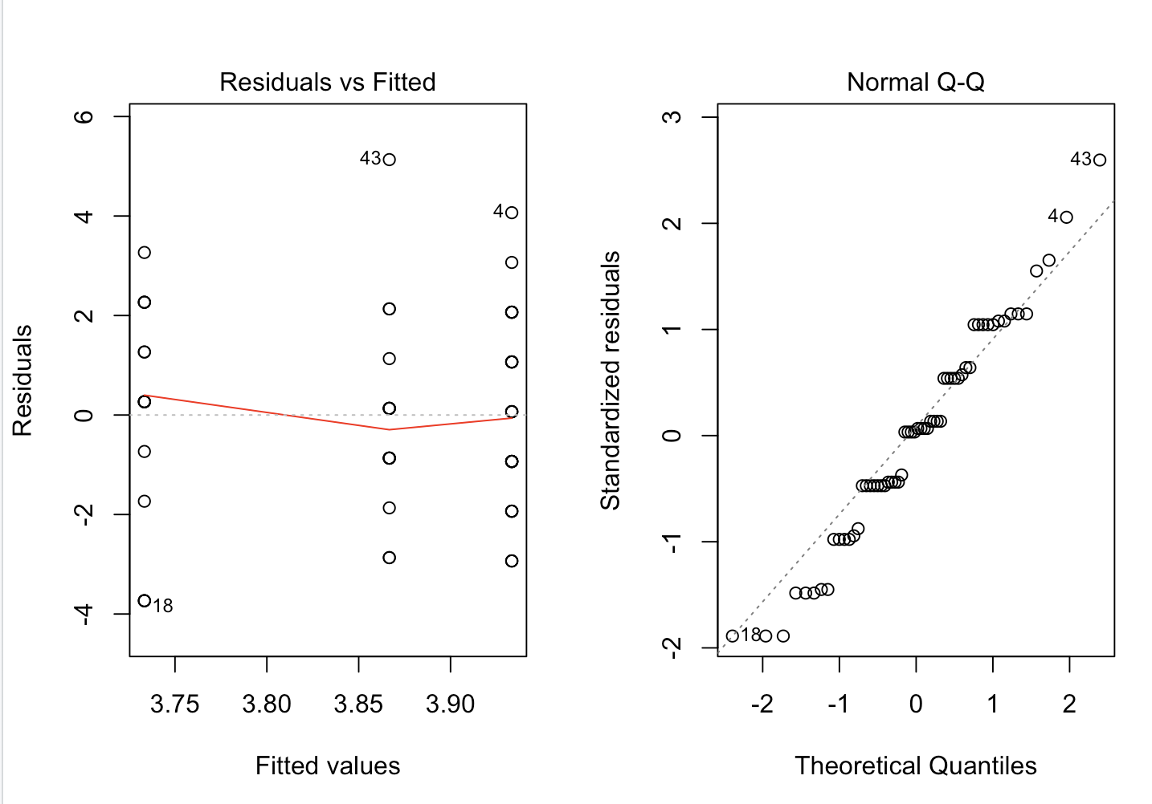
Results
The variance on the residuals plot are mostly constant
The Q-Q plot shows that the residuals are normally distributed
The requirements for a two-way ANOVA are met, and the results are trustworthy

Slide 6
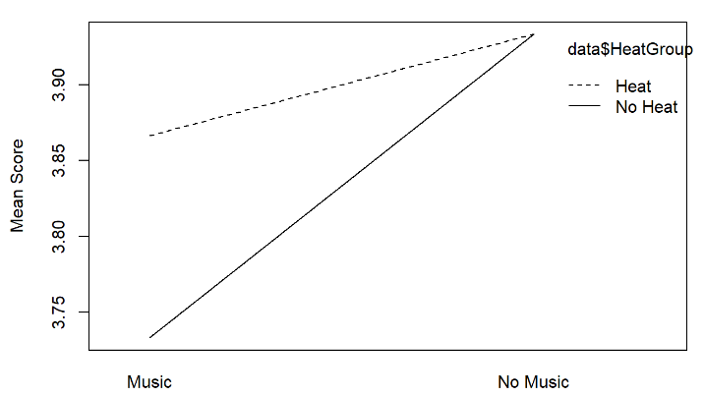
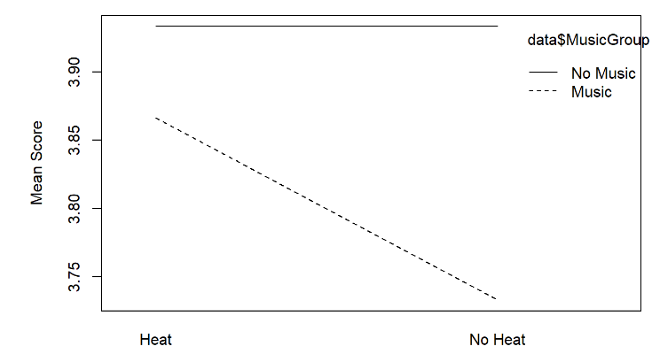
Results
There appears to be an interaction for those who participated in rooms with no music than those with music for both room controls of temperature difference (heat and no heat)
There appears to be no interaction of heat and no heat that had no music
Those with music and no heat had a smaller interaction than those with heat and music

Slide 7

Results
Descriptive Statistics for our heat factor

Slide 8
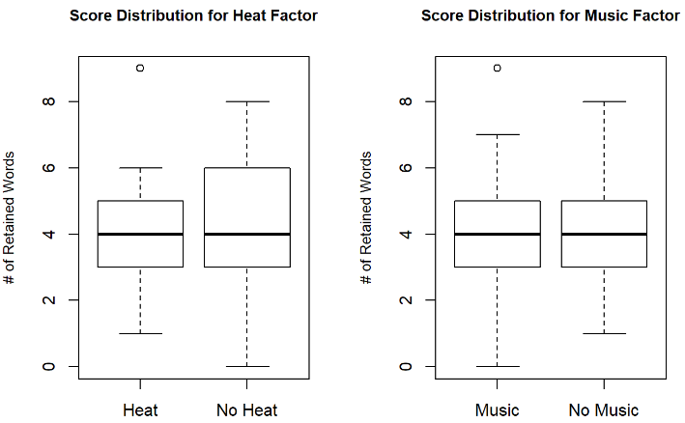
Results
Heat factor of heat versus no heat showed no significant difference
Music factor of music versus no music also showed no significant difference
The overall number of sets recalled did not differ given the controlled distractions

Slide 9
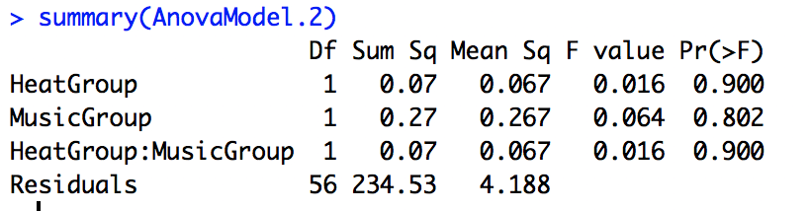
Results
ANOVA table

Slide 10
Discussion
Real world application
No relationship between music, heat, and memory
Cramming won’t work
Extra nuisance variables
Convenience sample (who participated)
Assignment of participants into rooms (randomly assign)
How we could do better next time
Account for nuisance variables
Would a longer test (more time for music to take effect) cause a different result?
Have the demographic information filled out immediately after consent form

Slide 11
References
Carlson, S., Rama, P., Artchkov, D., & Linnankoski, I. (1997). Effects of music and white noise
on working memory performance in monkeys. NeuroReport, 8(13), 2853-2856. Retrieved
from: https://www.ncbi.nlm.nih.gov/pubmed/9376518
Kang, Y., Williams, L. E., Clark, M. S., Gray, J. R., & Bargh, J. A. (2011). Physical temperature
effects on trust behavior: The role of insula. Social Cognitive and Affective Neuroscience,
6(4), 507-515. doi: 10.1093/scan/nsq077
Musliu, A., Berisha, B., Latifi, D. (2017). The impact of music in memory. European Journal of
Social Sciences Education and Research, 10(2), 222-227. doi: 10.26417/ejser.v10i2.

